Slide 1
SEARCH ENGINE
Presenters:-
Shiva Dev, Saikat Adhikary, Ayan Ghosh, Debajyoti Das

Slide 2
TABLE OF CONTENT:-
INTRODUCTION
DATABASE QUERY PROCESSING
INTERFACE B/W QUERY PROCESSING AND SEARCH RESULT
WEB CRAWLER
IR SYSTEMS FOR SEARCH ENGINE
TOOLS USED
OUR WORK

Slide 3
INTRODUCTION
A program that searches for and identifies items in a database that correspond to keywords or characters specified by the user, used especially for finding particular sites on the World Wide Web.

Slide 4
DATABASE QUERY PROCESSING
Query Processing includes translations on high level Queries into low level expressions that can be used at physical level of file system, query optimization and actual execution of query to get the actual result.

Slide 5
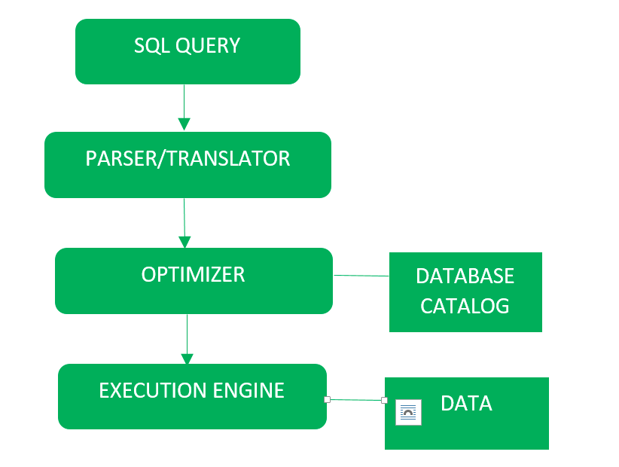

Slide 6
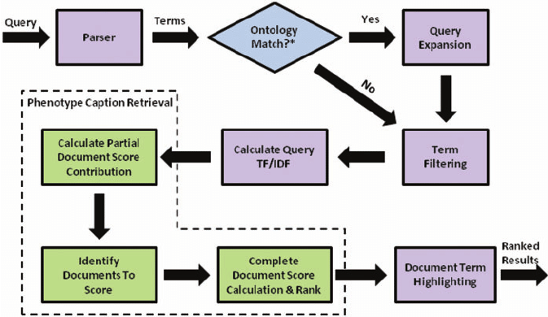
INTERFACE B/W QUERY PROCESSING AND SEARCH RESULT

Slide 7
WEB CRAWLER
A crawler is a program that visits Web sites and reads their pages and other information in order to create entries for a search engine index. The major search engines on the Web all have such a program, which is also known as a "spider" or a "bot."

Slide 8
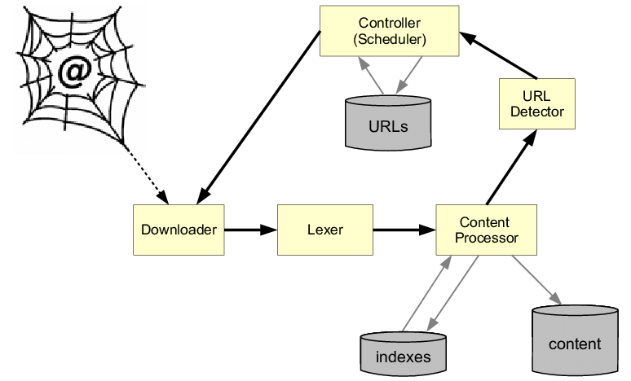

Slide 9
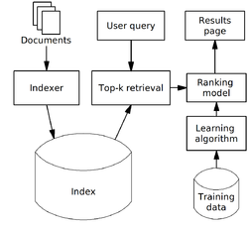
IR SYSTEMS FOR SEARCH ENGINE
Online Information retrieval system is one type of system or technique by which users can retrieve their desired information from various machine readable online databases.

Slide 10
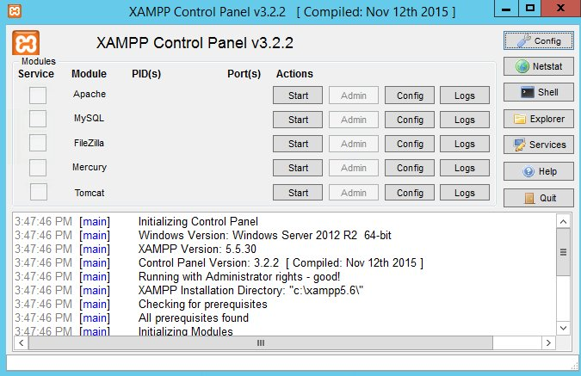
TOOLS USED :-
XAMPP CONTROL PANEL
WEB BROWSER
SUBLIME TEXT EDITOR

Slide 11
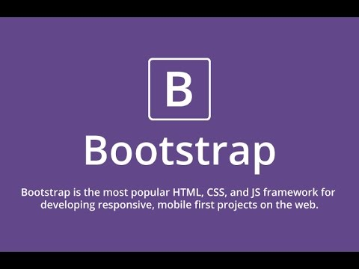


TOOLS USED :-
FRONT END:-
BOOTSTRAP TEMPLATES
JAVA SCRIPT
PHP
BACK END :-
APACHE
MySQL

Slide 12
WORKING PROCEDURE
1. Insert_site.php
Insertion of various of data like images, url, titles, keyword using html tags.
Insertion of data into database using php and mysql query.
2. Search.php
Searching conditions are processed and matched with the keywords which is already stored in DB.
3. Result.php
It will match the searched keywords with DB keyword
Results will be displayed related to the keyword.

Slide 13
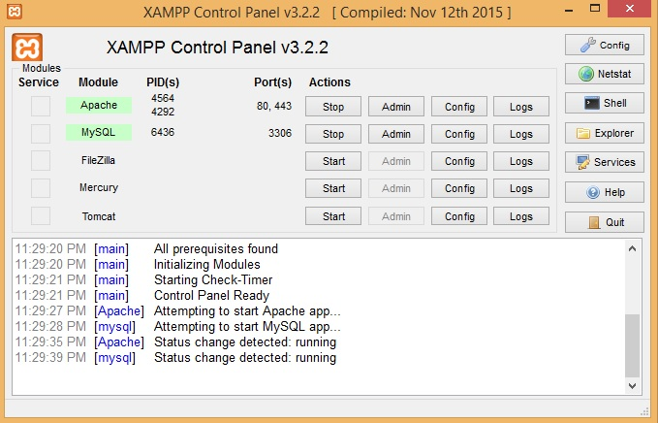
OUR WORK :-

Slide 14
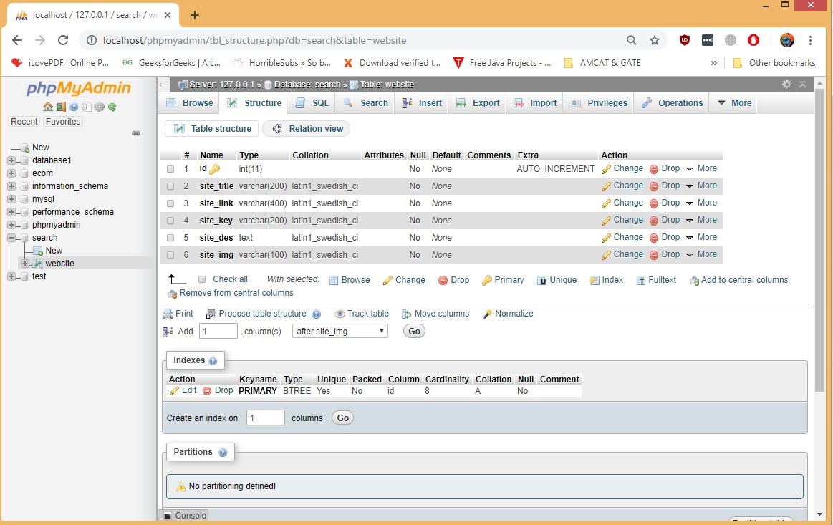

Slide 15
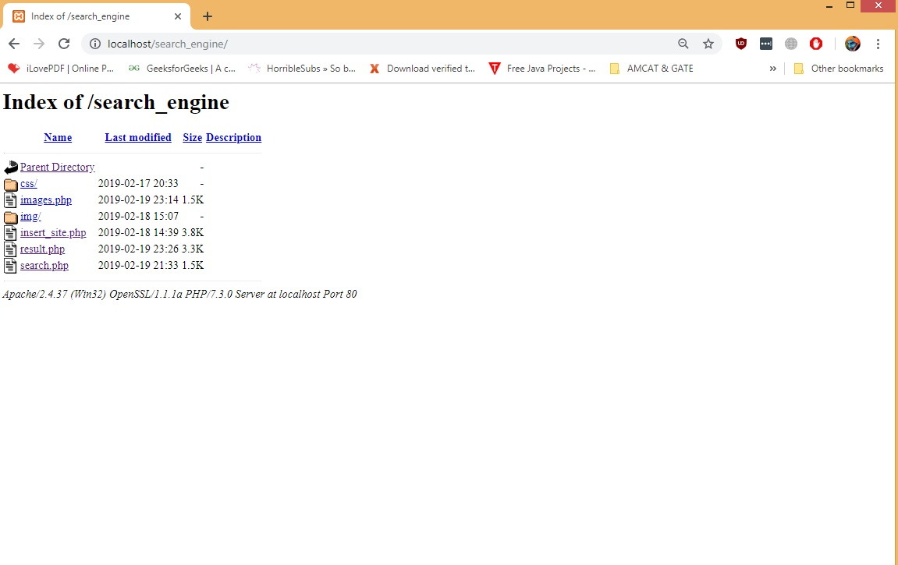

Slide 16
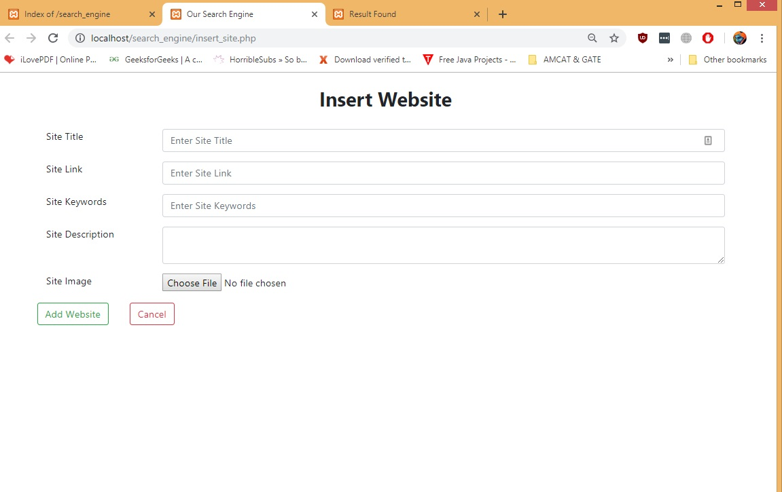

Slide 17


Slide 18
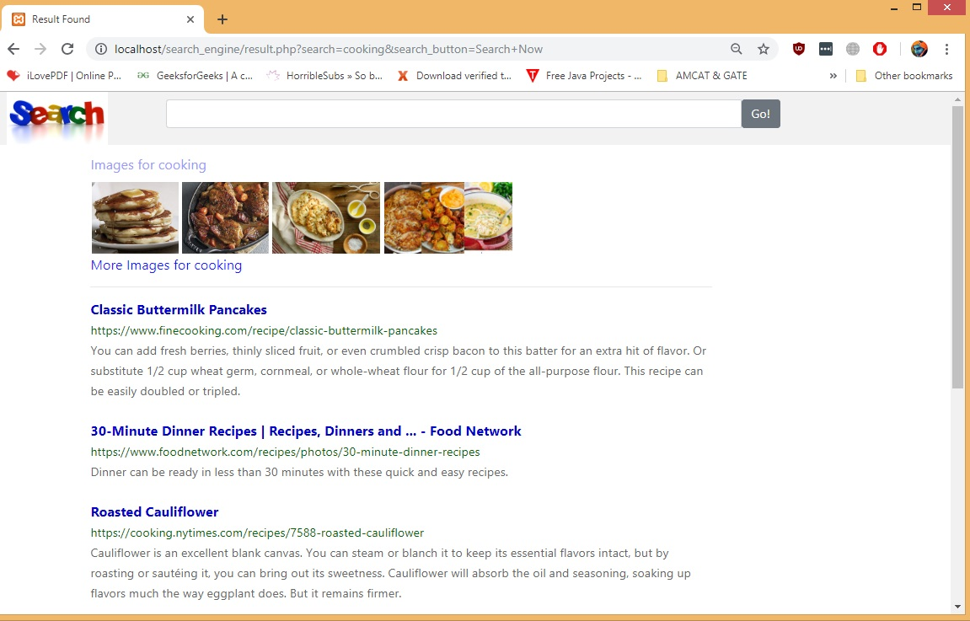

Slide 19
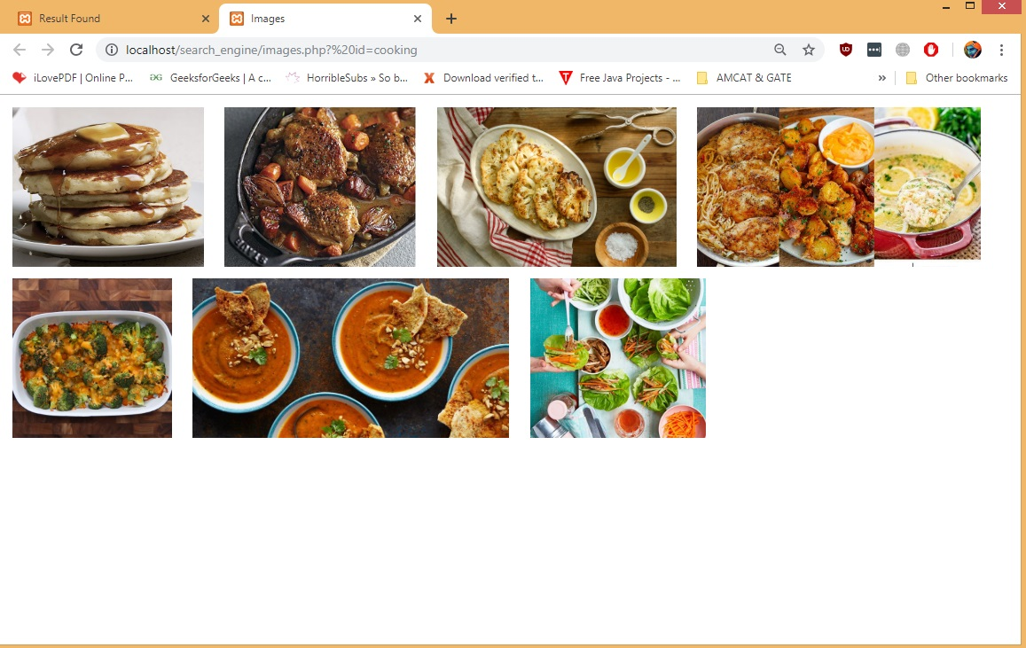

Slide 20
FUTURE PLANNING :-
We would like increase it’s database and deploy it commercially
We would like to deploy a brand new algorithm in our existing primitive algorithm.
We would like to increase our keyword processing efficiency.

Slide 21
THANK YOU!!!

